Slide 1

MatrIX CiNEMAS
Aneesh Partha
apartha@hawk.iit.edu

Slide 2
Objective
To create an application for Matrix cinemas which will allow a customer to book tickets in multiple theatres across different cities.

Slide 3
Requirements
Eclipse
Connection to Mysql sever (www.papademas.net)
SQL Yog(Community/Enterprise)/ Workbench
Scene builder
Javafx framework

Slide 4
JavaFX
Media/Graphics framework for creating GUIs in java application
It is a replacement of swing.
It is compatible to work with multiple platforms.
It features FXML – Language for defining UI.
It provides an application named scene builder(Gluon)
Javafx tutorial available in youtube
https://www.youtube.com/watch?v=9YrmON6nlEw&index=1&list=PLS1QulWo1RIaUGP446_pWLgTZPiFizEMq

Slide 5
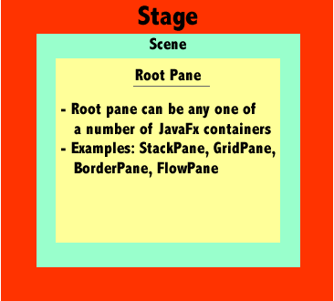
JavaFX

Slide 6
Database tables
Login ( Login details like username , password , user_type )
Customer (Customer details)
Admin (Admin details)
Card detail (Card details for payment)
Show ( Show details and show time)
Theatre ( Details like theatre name, city, state )
Screen (Available screens in each theatre)
Movierun (Combination of ids of tables movie , theatre , screen , show)
Movie (Details of movie)

Slide 7

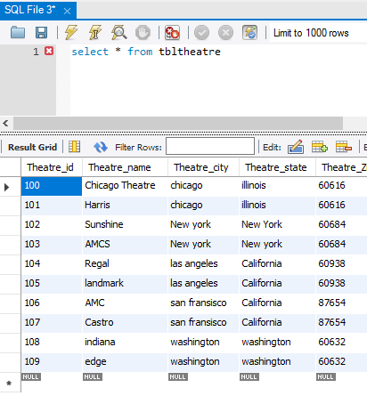
Theatre

Slide 8
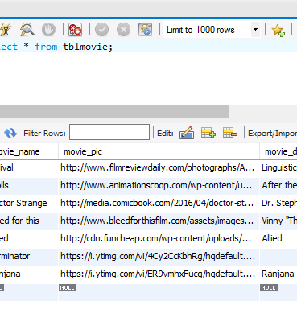
MOVIE

Slide 9
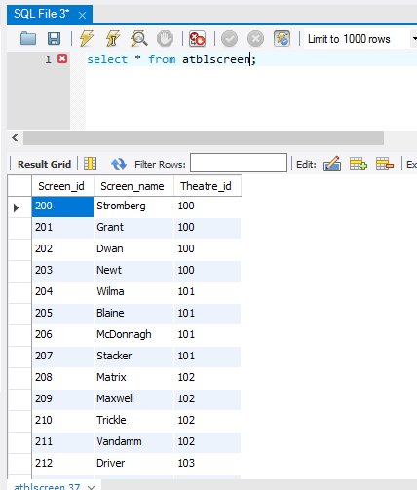
SCREEN

Slide 10
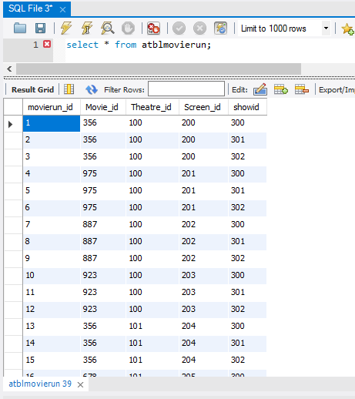
MOVIERUn

Slide 11
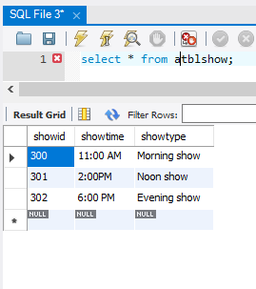
SHOW

Slide 12
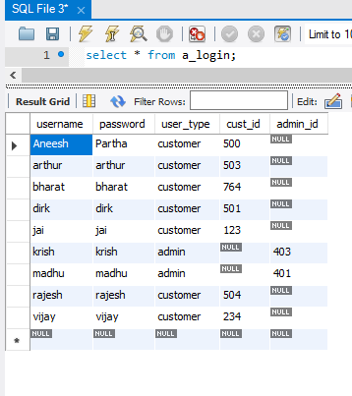
LOGIN

Slide 13
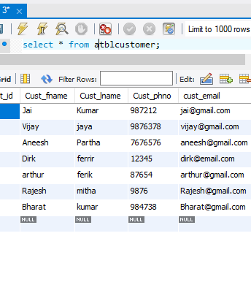
CUSTOMER

Slide 14
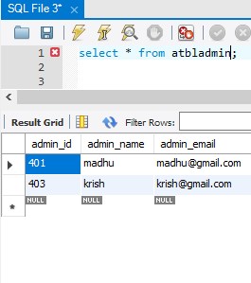
ADMIN

Slide 15
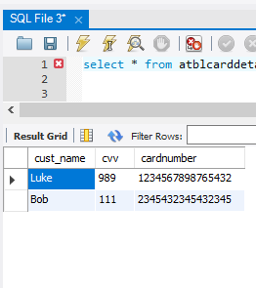
Card detail

Slide 16
DEMO

